Slide 1
REPASO con frases
Verbos modales
Voz pasiva
Present Perfect
Oraciones condicionales
Palabras terminadas en –ing
Cláusulas relativas

Slide 2

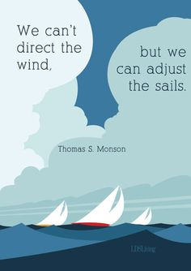
Verbos modales

Slide 3
Verbos modales
When they say you can’t, then you have to (expresión equivalente a must)
We can’t direct the wind, but we can adjust the sails.

Slide 4

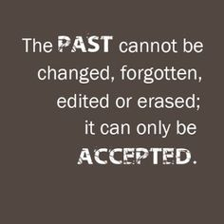
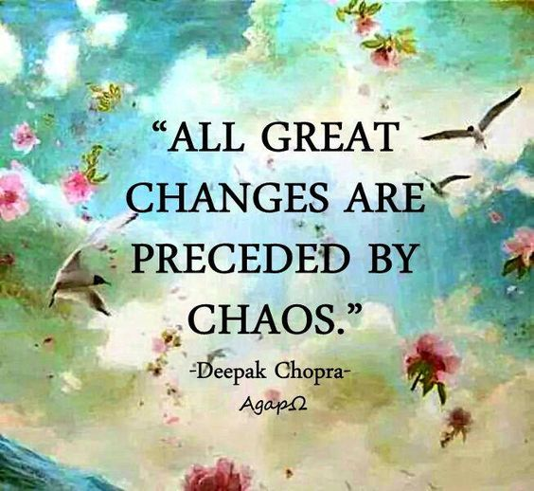
Voz pasiva

Slide 5
Voz pasiva
The past cannot be changed, forgotten, edited or erased , it can only be accepted.
All great changes are preceded by chaos.
Respect is earned. Honesty is appreciated. Trust is gained. Loyalty is returned.

Slide 6

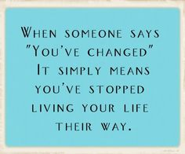
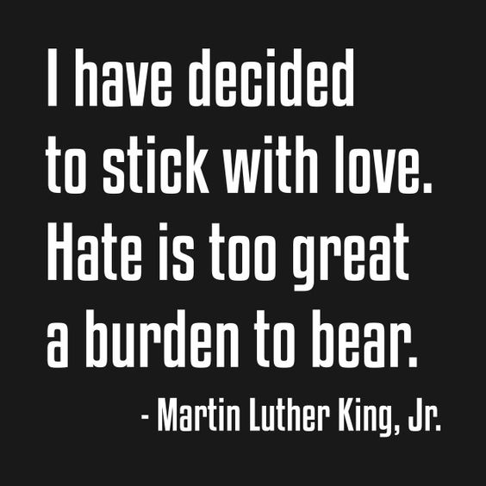
Present Perfect

Slide 7
Present Perfect
When someone says “you’ve changed”, it simply means you’ve stopped living (*) your life their way.
I have decided to stick with love…
Once a year, go somewhere you’ve never been before.
(*) Present Perfect Continuous

Slide 8

Condicionales: tipo 0
You learn something everyday if you pay attention.

Slide 9


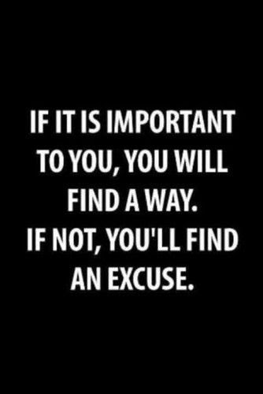
Condicionales: tipo 1

Slide 10
Condicionales: tipo 1
If opportunity doesn’t knock, build a door.
You can never cross the ocean unless you have the courage to lose sight of the shore.
If it is important to you, you will find a way. If not, you’ll find an excuse.

Slide 11

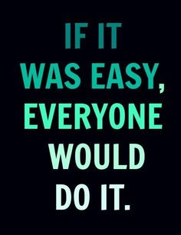
Condicionales: tipo 2

Slide 12
Condicionales: tipo 2
If it was easy, everyone would do it.
If you truly loved yourself, you could never hurt another.

Slide 13



Palabras terminadas en -ing

Slide 14
Palabras terminadas en -ing
Educating the mind without educating the heart is no education at all.
The beautiful thing about learning is that no one can take it from you.
Worrying is like walking around with an umbrella waiting for it to rain.

Slide 15

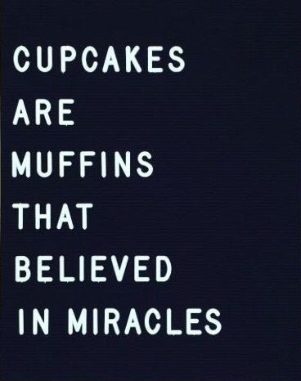
Cláusulas relativas

Slide 16
Cláusulas relativas
People who do not understand your silence will never understand your words.
Cupcakes are muffins that believed in miracles.

Slide 17
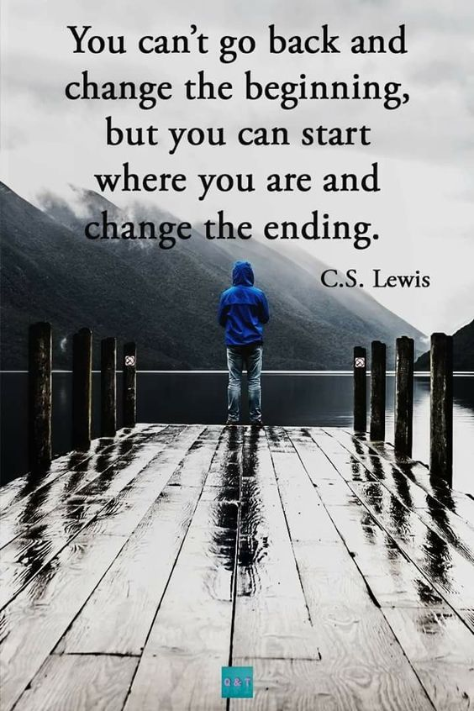
“No puedes regresar y cambiar el principio, pero puedes comenzar donde estás y cambiar el final.”
can’t go back / can start: modales
beginning / ending: sustantivos

